Slide 1
Name : Ritik Samanta College : Vivekanand Business School PGDM -Business Analytics

Slide 2
Project Details
Movie Similarity Analysis : Implementing a Python solution to identify movies that are similar to each movie based on the plot, without considering factors such as genre, director, cast.
Solution : Aim to perform data science tasks on an open movie dataset, with a focus on text preprocessing and similarity analysis. The dataset is loaded from a CSV file, and the text data undergoes different analysis techniques.
Data set : Bollywood Movie dataset from 1951 to 2023 contains 8 columns & 2199 rows. (https://github.com/devensinghbhagtani/Bollywood-Movie-Dataset)
Libraries Used
Pandas
Nltk : stopwords, word_tokenize, WordNetLemmatizer,
Sklearn : TfidfVectorizer, Kmeans, PCA, cosine_similarity,
Scipy : hierarchy
Numpy
Matplotlib

Slide 3

Purpose : Movie similarity analysis aims to identify and quantify similarities between different movies based on Plot Analysis
Aim : Develop a ML model to analyze and compare movie plots, extracting key plot features and patterns, with the goal of accurately measuring and quantifying the similarity between different movies.

Slide 4
Flow of Steps
Step 1 : Loading and Exploring the Dataset
Step 2 : Text Preprocessing : Tokenization, Lemmatizing
Step 3 : Vectorize Text Data
Step 4 : Importing KMeans & Creating Clusters to plot it
Step 5 : Compute Similarity
Step 6 : Importing Matplot, Linkage
Step 7 : Finding Similar Movies

Slide 5
FUNCTIONS USED
COSINE SIMILARITY
Robust to document length
Efficient for sparse data
Widely used in Information Retrieval
Simplicity and Interpretability
Stability
OTHER OPTIONS
Jaccard Index
Manhattan Distance
Euclidean Distance
Minkowski Distance
Hamming Distance

Slide 6
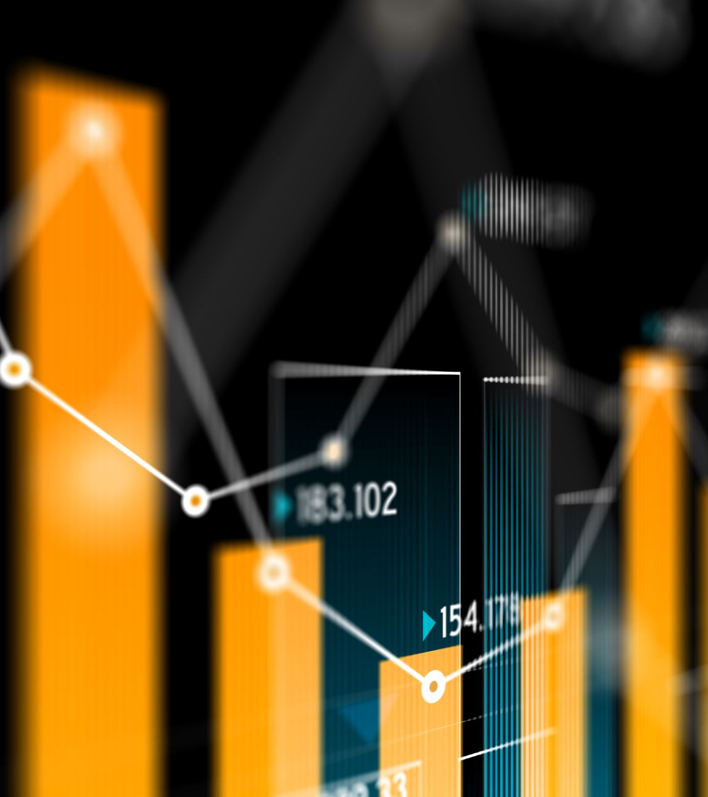
Conclusion
This data science project provides insights into movie similarity based on textual information.
The use of text preprocessing, clustering, and similarity computation allows for a comprehensive analysis of the dataset,offering a valuable tool for movie recommendation systems.
We could use this algorithm and integrate it into a web project to make it more interactive and useful.

